Slide 1
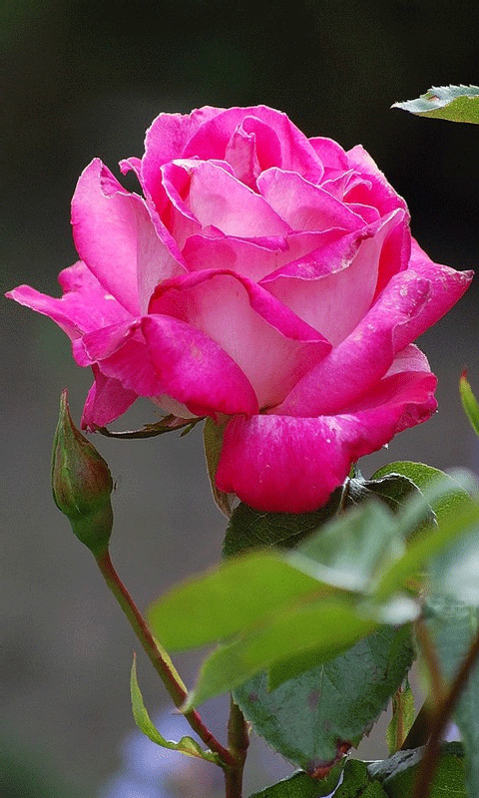
Welcome

Slide 2
Anayet Rabbi
Assistant Teacher
Dakkhin Char Ishwar Ray G.P.S
Hatiya, Noakhali

Slide 3
Lesson Introduction:
Class- Two
Subject- English
Unit-16
Lesson-4
Time- 45 m
Date- 22.03.2019

Slide 4
Students will be able-----
to say the name of seven
colours.
to identify the seven colours
with colour’s name.
1.1.1
1.1.2

Slide 5
What about the video?

Slide 6
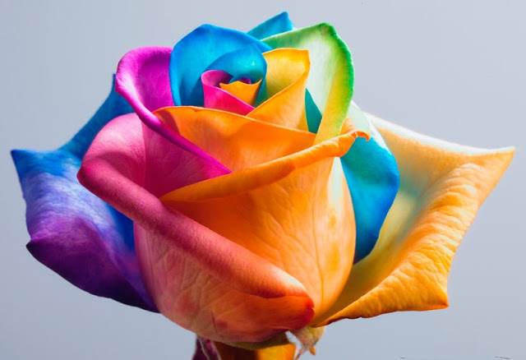
Today’s Lesson:
“Colours”

Slide 7
What Is This
This is rainbow

Slide 8
Look very attentively----

Slide 9
Look, listen & say:
red.

Slide 10
Look, listen & say:
orange.

Slide 11
Look, listen & say:
Yellow.

Slide 12
Look, listen & say:
green.

Slide 13
Look, listen & say:
Blue.

Slide 14
Look, listen & say:
Indigo.

Slide 15
Look, listen & say:
Violet.

Slide 16
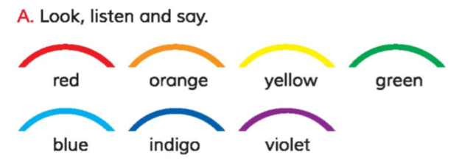
Open your English book at page-33
and see the Activity -A

Slide 17
What colour are missing?
Missing Game
Student will be able missing colour name

Slide 19
Look, listen & do:
I.W
yellow
indigo
red
violet
orange
green
Click the colour
blue

Slide 20
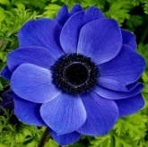
Match the words with colours:
G.W-7
violet
blue
Showing chart
Indigo
yellow
green
red
orange
click
Notes:
I’ll show a chart. Students will be divided into seven groups. Each group match the colour with colours name.

